Slide 1
Lecture-9
Structures, Unions & Bitwise Operators

Slide 2
We’ll Learn Today
Recall Arrays
Mixed-type data structures
Declaring, Defining & Initializing Structures
Passing Structures to Functions
Arrays of Structures
Accessing Structure Elements Using Pointers
Malloc( ) Function
Unions
Bitwise Operators
Exercise
Project

Slide 3
Arrays
Recall the properties of a C array.
It has a fixed size (determined at compile time);
It contains fields of a fixed type. (eg. int).
It has a name; (eg marks)
You can reference many items through that name; (eg marks[4], marks[7]). In C, the array data
has an explicit storage order. eg marks[10] is immediately after marks[9].
However there are other applications where arrays are not adequate or cannot be used at all.
These applications can be recognized from the lack of the above attributes:
If the data is not all of one type,
If the size varies while the program runs,
then an array should not be used.

Slide 4
Mixed-type data structures
Problem:
don't know what forms these are going to take because applications (and programmers) are not predictable.
Solution:
instead of building in one or more specialised structures, C incorporates a mechanism to allow you to define new structures to suit your application: the struct denition.

Slide 5
Declaring Structures
Here is an example of the form:
struct date
{
int day;
int month;
int year;
char month_name[10];
};
Note:
The keyword struct and the use of curly brackets (braces) to delimit the declaration. Most importantly, all we have said so far is what the shape" of date is; we have not created any variables.
So, we can define variables of this type with:
struct date d;

Slide 6
Declaring Structures (cont’d)
What this gives us is a variable called d, an information record with (in this case) four members (day, month, year, month_name). Each member can be of a different type and hence of a different length.
The generic structure has a name (date). The specic variable has a name (d).
We can refer to fields within the record by use of the form:
    d.day
    d.month
    d.year
    d.month_name
In this example, the last of these is a character array, so we can pick out individual characters, for example with
d.month_name[3]

Slide 7
Simple Program
#include <strings.h> /* We need the system-provided strcpy() */
int main()
{
struct date /* declare the shape of date */
{
  int day;
  int year;
char month_name[10];
};
struct date d; /* create a variable d of type date */
    d.day= 25;
    strcpy(d.month_name,"January");
    d.year= 1991; /* suppose positive is A.D. */
printf("Day= %d Month= %s Year= %d\n",
d.day,d.month_name,d.year);
}

Slide 8
structs combined to make more elaborate structures
We have already seen that a struct can contain an array.
A struct can also contain another struct:
struct person
{
  char person_name[20];
  struct date birth_date;
  struct date death_date;
  }
To access the various members we simply extend the dot notation. For example, given
struct person p;
we can refer to that person's birthdate as
p.birth_date
and the year of that person's birth is:
p.birth_date.year
while the first letter of the month of birth is:
p.birth_date.month_name[0]

Slide 9
structs combined to make more elaborate structures
Similarly you can have arrays of structs:
struct person Q5_class[130];
Gives an array, each item of which (e.g. Q5_class[27]) is a struct of type person. Thus you can refer to:
Q5_class[27].name etc.
You have fully flexibility in combining C data structures in any way you wish. As in any aspect of programming, it pays to choose the data structure which most simply serves the need of the problem being solved. One of the main reasons we use computers is to avoid doing complex things ourselves.

Slide 10
Defining structs and variables together
A struct can be declared and variables of its type can be defined simultaneously:
  struct complex
  {
  double real_part;
  double imag_part;
  } x, y, z[10];
Defines three variables of type complex, one of which is a ten-element array.
Note that this is syntactically the similar to int x, y, z[10]

Slide 11
Initializing structs
A struct variable can be initialized as it is declared:
struct date d= { 3, 5, 1930,"May" };
In this case it is of course necessary to give the initial values in the order that the members were declared.

Slide 12
Passing Structures to Functions
struct emp input (void)
{ struct emp a;
printf(“Enter Eno: “);
scanf(“%d”, &a.eno);
printf(“Enter Ename: “);
gets(a.ename);
return(a);
}
void display ( struct emp a)
{
printf(“\nEmployee No:%d”,a.eno);
printf(“\nEmployee Name:);
puts(a.ename);
}
struct emp
{
  int eno;
  char ename[20];
  };
struct emp input (void);
void display ( struct emp);
void main(void)
{
struct emp e1;
e1=input( );
display ( e1 );
}

Slide 13
Arrays of Structures
void main(void)
struct emp
{
  int eno;
  char ename[20];
  }struct emp e[5];
  int i;
  for(i=0;i<5;i++)
  { clrscr();
  printf(“Enter Eno: “);
  scanf(“%d”, &e[i].eno);
  printf(“Enter Ename: “);
  gets(e[i].ename);
  }
for(i=0; i<5; i++)
{
printf(“\nEmployee No: %d ” ,
e[i] .eno ) ;
printf(“\nEmployee Name:);
puts(e[i].ename);
}
getch();
}

Slide 14
Accessing Structure Elements Using Pointers
void main(void)
{ struct emp
{ char eno; char ename[20]; }
struct emp e1;
struct emp *ptr;
e1.eno=1;
strcpy(e1.ename,”Asad”)
ptr=&e1;
printf(“Employee No: %d” , ptr->eno);//(*ptr).eno)
printf(“Employee Name: “);
puts( ptr->ename);
}

Slide 15
malloc()
Definition:
In computing, malloc( ) is a subroutine provided in the C programming language’s standard library for performing “ Dynamic Memory Allocation “
Example:
void main(void)
{ int *ptr;
ptr=( int * ) malloc(2);
*ptr = 100;
printf(“Value is: %d”, *ptr);
printf(“Address is: %d”, ptr);
}

Slide 16
malloc() (con’td)
void main(void)
{ struct emp
{ int eno;
char ename[20]
}struct emp *ptr;
ptr=(struct emp * ) malloc(sizeof(struct emp));
ptr->eno=1;
strcpy((*ptr).ename,”Asad”);
printf( “ Emp No. :%d “, ptr->eno);
printf(“ Emp Name: “);
puts(ptr->ename);

Slide 17
Self-Referential Structures
A structure cannot contain an instance of itself. For example, a variable of type struct employee cannot be declared in the definition for struct employee.
A pointer to struct employee, however, may be included.

Slide 18
Structure Tag Names
The structure tag name is optional. If a structure definition does not contain a structure tag name, variables of the structure type may be declared only in the structure definition—not in a separate declaration.

Slide 19
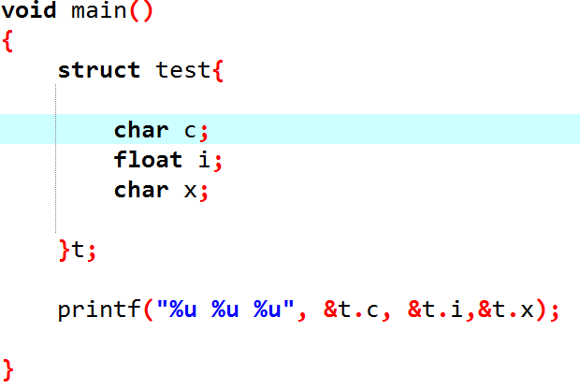
“holes” in a structure

Slide 20
typedef
The keyword typedef provides a mechanism for creating synonyms (or aliases) for previously defined data types. Names for structure types are often defined with typedef to create shorter type names. e.g.
typedef struct card Card;
Card deck[20];

Slide 21
Union
union
  Memory that contains a variety of objects over time
  Only contains one data member at a time
  Members of a union share space
  Conserves storage
  Only the last data member defined can be accessed
union definitions
  Same as struct
      union Number {
      int x;
      float y;
      };
      union Number value;

Slide 22
Union (con’td)
Valid union operations
  Assignment to union of same type: =
  Taking address: &
  Accessing union members: .
  Accessing members using pointers: ->

Slide 23
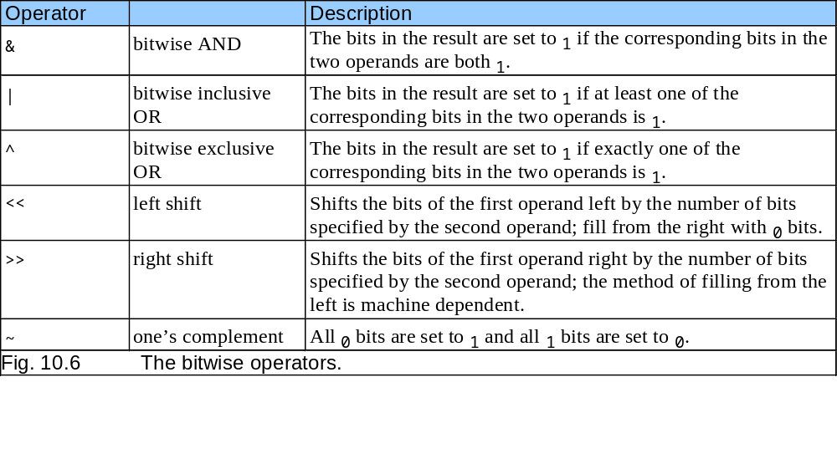
Bitwise Operators
All data represented internally as sequences of bits
  Each bit can be either 0 or 1
  Sequence of 8 bits forms a byte

Slide 24
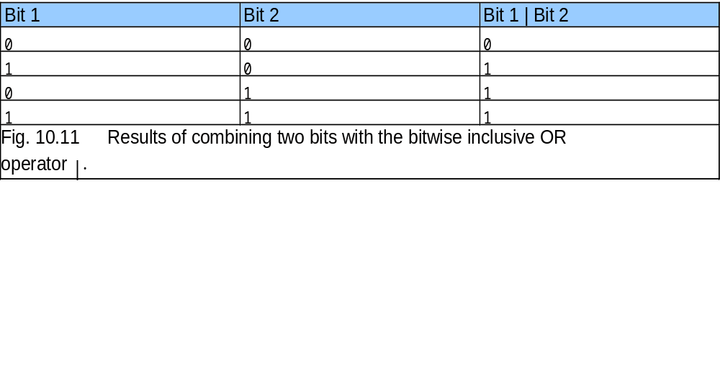
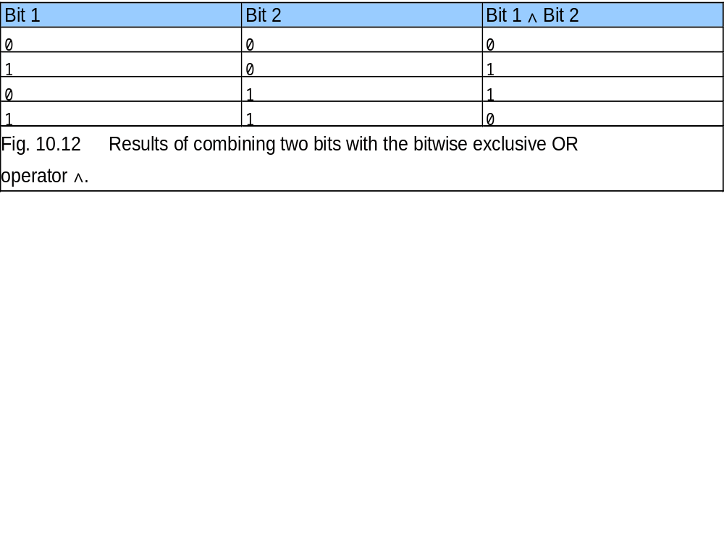
Bitwise Operators (con’td)

Slide 25
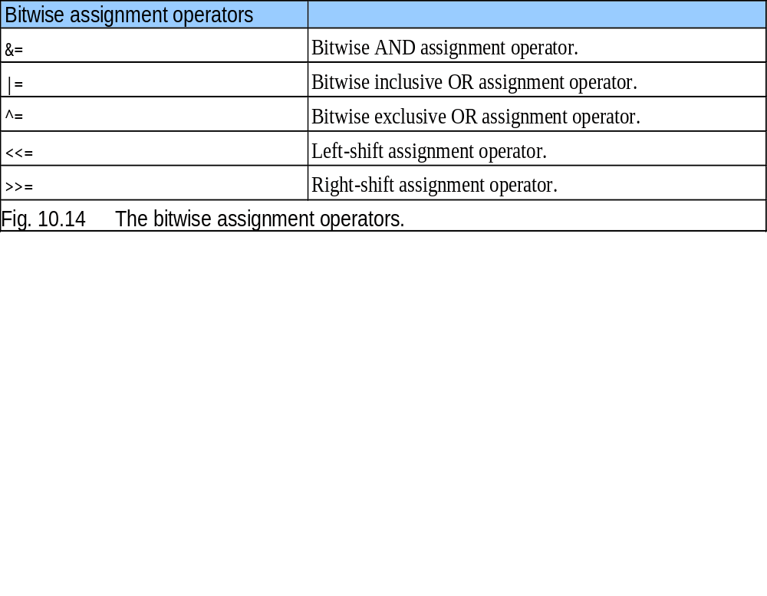
Bitwise Operators (con’td)

Slide 26
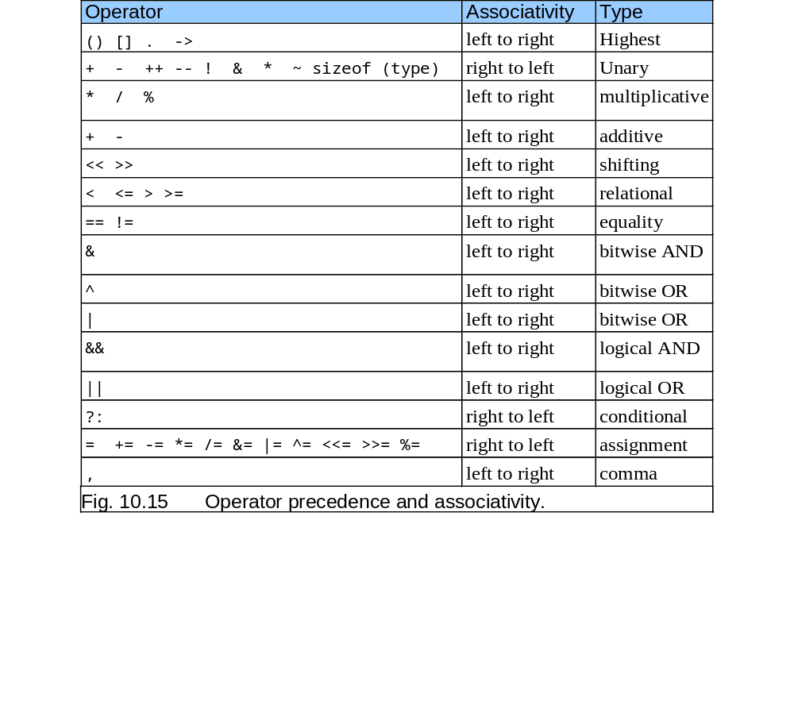
Bitwise Operators (con’td)

Slide 27
Conceptual View
The shift operators perform appropriate shift by operator on the right to the operator on the left. The right operator must be positive. The vacated bits are filled with zero (i.e. There is NO wrap around). For example: x << 2 shifts the bits in x by 2 places to the left.
So:
if x = 00000010 (binary) or 2 (decimal)
  then:
  or 0 (decimal)
  Also: if x = 00000010 (binary) or 2 (decimal)
  or 8 (decimal)
  Therefore a shift left is equivalent to a multiplication by 2.
  Similarly a shift right is equal to division by 2
  NOTE:
Shifting is much faster than actual multiplication (*) or division (/) by 2. So if you want fast multiplications or division by 2 use shifts.

Slide 28
Exercise
Write any program that pass arrays of structure to the function.
Write a function that inverts the bits of an unsigned char x and stores answer in y.
Your answer should print out the result in binary form. Your output should be like this:
x = 10101010 (binary)
y inverted = 01010101 (binary)
Write a program that takes input in Decimal form and then convert it into Binary, Hexadecimal, and Octal Number systems. Your output should be like this:
Decimal: 15
Binary: 1111
Octal: 17
Hexa: F

Slide 29
Project #1
Create a structure to specify data on students given below:
Roll#, Name, Department, Course, Year of Joining
Write a function to input student data for 100 students.
Write a function to print the names of all students who joined in a particular year.
Write a function to print the data of a student whose roll number is given.

Slide 30
End of Lecture-8
Any Questions ???

